Slide 1
The CIMSS iPad Library & the
GOES-R Education Proving Ground
Margaret Mooney
Cooperative Institute for Meteorological Satellite Studies (CIMSS)
Space Science and Engineering Center, (SSEC)
University of Wisconsin-Madison
Satellites & Education XXVII
Notes:
This presentation will outline connections between the Climate Literacy Ambassadors community and ESIP Teacher Workshops before delving into details about the new iPad Library and SatCam. We will discuss considerations and challenges related to a technology loaning library, software recoding to HTML5, and some advantages and limitations related to iPads. We will also share feedback acquired over the fall from ESIP Educators using the SatCam App with their students with the iPads they borrowed (like books) from the CIMSS iPad Library

Slide 2
About CIMSS Cooperative Institute for Meteorological Satellite Studies
CIMSS is a Cooperative Institute between:
University of Wisconsin-Madison
NOAA
NASA
CIMSS operates within the UW-Madison Space Science and Engineering Center (SSEC)
CIMSS & SSEC are renown for satellite remote
sensing research and imagery.
CIMSS Education and Outreach efforts
prioritizes weather and climate literacy
http://cimss.ssec.wisc.edu/education

Slide 3
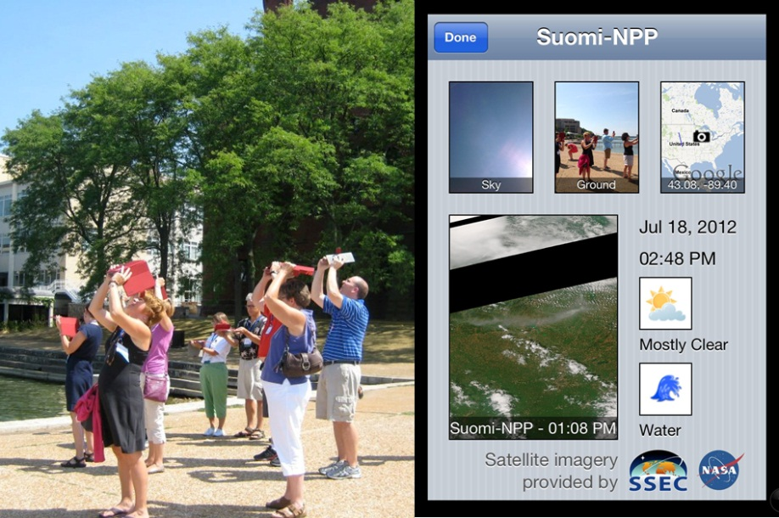
CIMSS iPad Library
In 2012 CIMSS launched a new initiative to engage teachers and students in data acquisition and regional climate studies. The CIMSS iPad Library loans iPads to science teachers for an entire school year! For the first two years, iPads were distributed at ESIP Teacher Workshops, the 2014-15 school year marks the third year of this technology lending library.

Slide 4
http://cimss.ssec.wisc.edu/education/cla/iLibrary

Slide 5
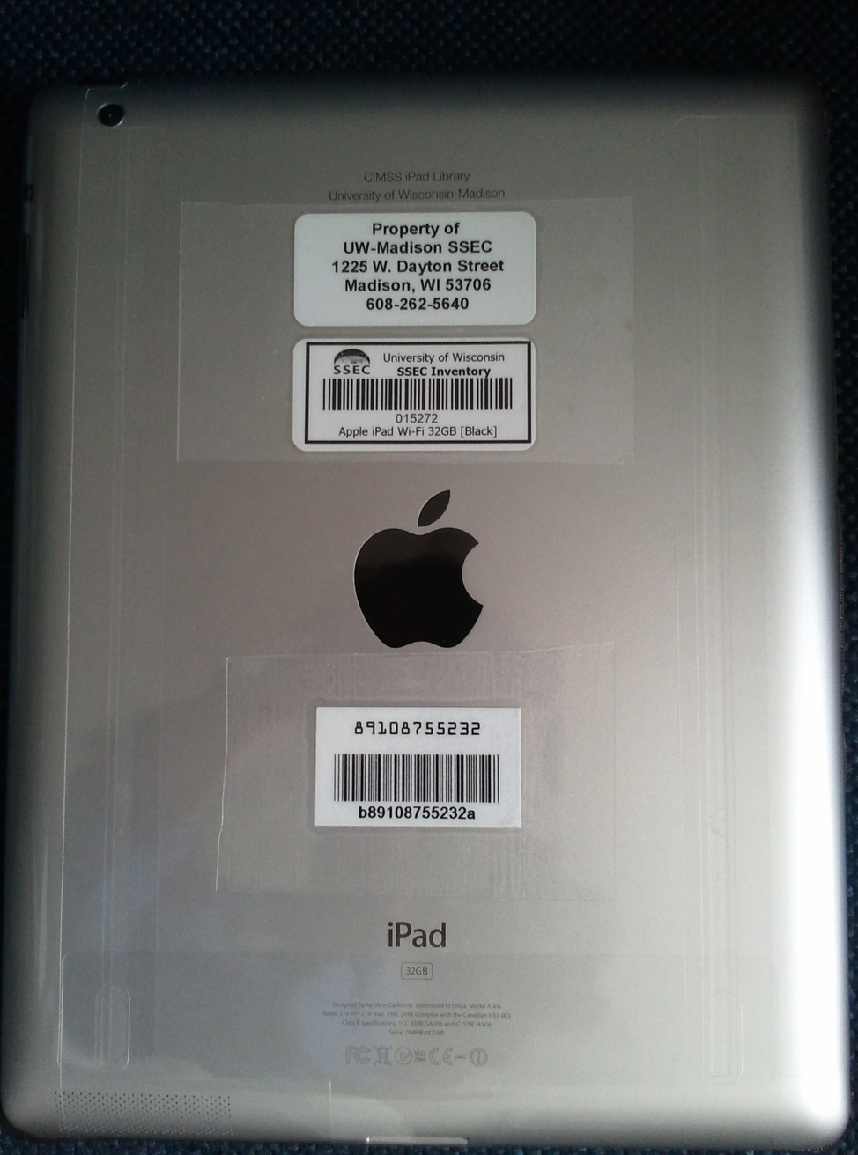
CIMSS iPad Library iPads with bar codes & loan agreement forms

Slide 6
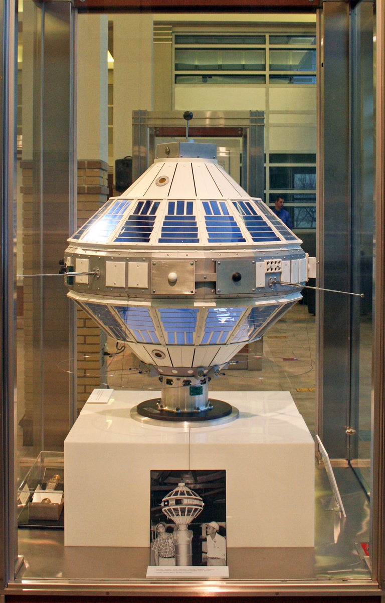
The Schwerdtfeger Library 3rd floor AOSS (1225 W. Dayton)
The CIMSS iPad Library is coordinated by the Schwerdtfeger Library at Space Science and Engineering Center. (SSEC)
An iPad loan agreement includes accessories and case. Along with a unique iPad ID, each unit includes a library bar code. (just like books!)
The Schwerdtfeger Library supports the research and development goals of the SSEC, NOAA scientists and their affiliates, and provides instructional support to atmospheric and oceanic science faculty, graduate students and others.
Notes:
The road to today’s weather satellite technology began in Madison, WI more than half a century ago. Verner Suomi, a University of Wisconsin professor of meteorology, along with Robert Parent, a University of Wisconsin professor of electrical engineering, began devising experimental meteorological instruments to be launched into space in the 1950s. On 13 October 1959 Suomi and Parent achieved a major milestone when the first successful meteorological experiment was launched on Explorer 7. Their radiometer made it into orbit and operated as envisioned. A full scale model of the satellite and instrument is on display in the SSEC

Slide 7
Satellite Timeline
An interactive timeline of satellite meteorology spanning more than 50 years. (Sputnik to GOES-R!)
http://library.ssec.wisc.edu/timeline/

Slide 8
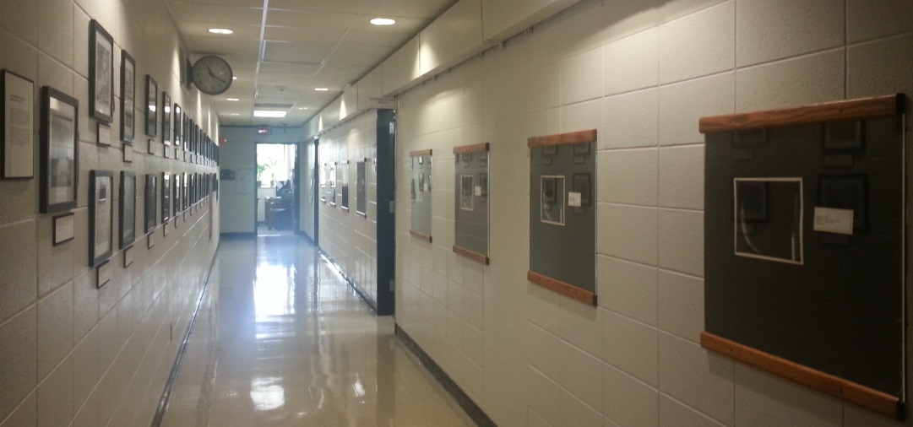
New Exhibit: Images from the ATS-III Spin-Scan Camera
Satellite photographs of Earth captured sequentially in November 1967 by the Multicolor Spin-Scan Cloud Camera aboard the Applications Technology Satellite III (ATS-III).
The Spin-Scan camera revolutionized weather forecasting by providing composite images of Earth every 20 minutes and synoptic-scale views of cloud movement and development.
("the clouds moved not the satellite" Verner Suomi)

Slide 9
GOES-R Education Proving Ground
The GOES-R Education Proving Ground features the design and development of pre-and post-launch lesson plans and activities for G6-12 teachers and students in collaboration with NOAA scientists at the Advanced Satellite Products Branch (ASPB) at CIMSS.
2016
Intended Project Outcomes
- Awareness of NOAA’s contributions to satellite remote sensing applications
- Increased utilization of satellite data in science classrooms
- Improvements in science literacy
- Effective transfer of GOES-R satellite products to the educational community

Slide 10
GOES-R Education Proving Ground some background
Year 1:
Updates & revisions to Satellite Meteorology for Grades 7-12
http://cimss.ssec.wisc.edu/satmet/
Year 2:
Promote at AMS, ESIP & Satellite Educators Conference
Recruit Educators to the GOES-R Education Proving Ground
Develop pre and post-launch activities using existing GOES data
Year 3: (now!)
Develop and test activities and lesson plans
Plan launch and post-launch activities
Notes:
Education Proving Ground – small but strong:
Our current plan is to engage six dedicated teachers; three teams of two colleagues working in the same school system, one team from California, one team from Wisconsin and team from Florida. This core group of six teachers would work with CIMSS until and after the 2015 launch date. Our long term goal is to have teachers attend the launch, working in collaboration with Prof Rusher, CIMSS scientists and Dr. Nina Jackson.

Slide 11
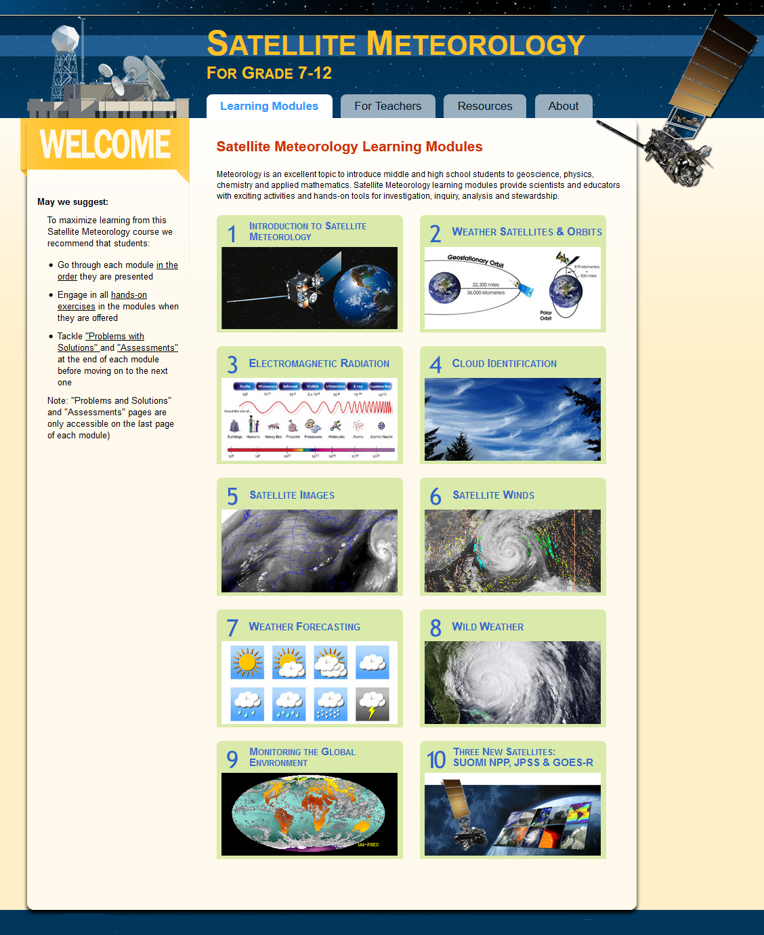
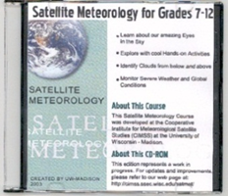
Satellite Meteorology for Grades 7-12
NEW MODULE!
Next Gen Satellites
Suomi NPP
JPSS
GOES-R

Slide 12
http://cimss.ssec.wisc.edu/education/goesr/

Slide 13
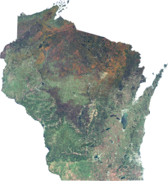
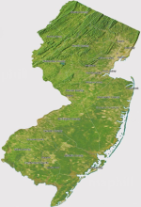
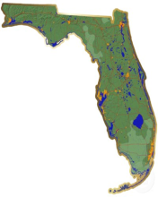
GOES-R Educators
WISCONSIN
Craig Phillips – Baraboo Middle School
Brian Witthun – Baraboo Middle School
NEW JERSEY
Peter Dorofy - Palmyra Cove Environmental Discovery Center
Vicky Gorman – Medford Memorial Middle School
FLORIDA
Charlotte Besse - New Smyrna Beach High School
Amy Monahan - Volusia County Schools STEM educator
Our goal is to prepare the education community to be launch ready for imagery and products that will be available in the GOES-R era.

Slide 14
The CIMSS iPad Library & the
GOES-R Education Proving Ground
JOIN US!
Borrow an iPad
Test a lesson plan
Share the excitement!
Satellites & Education XXVII
Notes:
This presentation will outline connections between the Climate Literacy Ambassadors community and ESIP Teacher Workshops before delving into details about the new iPad Library and SatCam. We will discuss considerations and challenges related to a technology loaning library, software recoding to HTML5, and some advantages and limitations related to iPads. We will also share feedback acquired over the fall from ESIP Educators using the SatCam App with their students with the iPads they borrowed (like books) from the CIMSS iPad Library

